Slide 1
Pose Estimation - Python OpenCV
by,
SIVARAJ D ( 205229140)

Slide 2
What is Pose Estimation?
Pose estimation is a computer vision technique that is used to predict the configuration of the body(POSE) from an image.
The reason for its importance is the abundance of applications that can benefit from technology.
Human pose estimation localizes body key points to accurately recognize the postures of individuals given an image.
These estimations are performed in either 3D or 2D.

Slide 3
What is OpenCV ?
OpenCV is an open-source library mainly used for computer vision, image processing, and machine learning.
It gives better output for real-time data, with the help of OpenCV, we can process images and videos so that the implemented algorithm can be able to identify objects such as cars, traffic signals, number plates, etc., and faces, or even handwriting of a human.
With the help of other data analysis libraries, OpenCV is capable of processing the images and videos according to our desire.

Slide 4
What is Mediapipe?
Mediapipe is a framework mainly used for building multimodal audio, video, or any time series data.
Media Pipe Pose is a framework for high-fidelity body pose tracking, which takes input from RGB video frames and infers 33 3D landmarks on the whole human.
Current state-of-the-art approach methods rely primarily on powerful desktop environments for inferencing, whereas this method outperforms other methods and achieves very good results in real-time.
Cutting edge ML models using Mediapipe :
Face Detection
Multi-hand Tracking
Hair Segmentation
Object Detection and Tracking
Pose Estimation

Slide 5
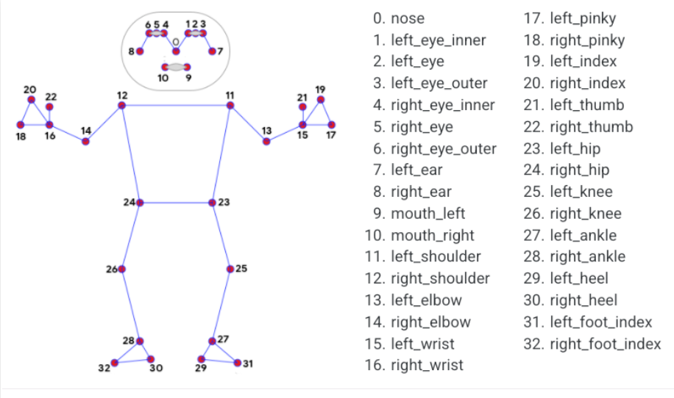
Pose Landmark Model

Slide 6
CODING

Slide 7
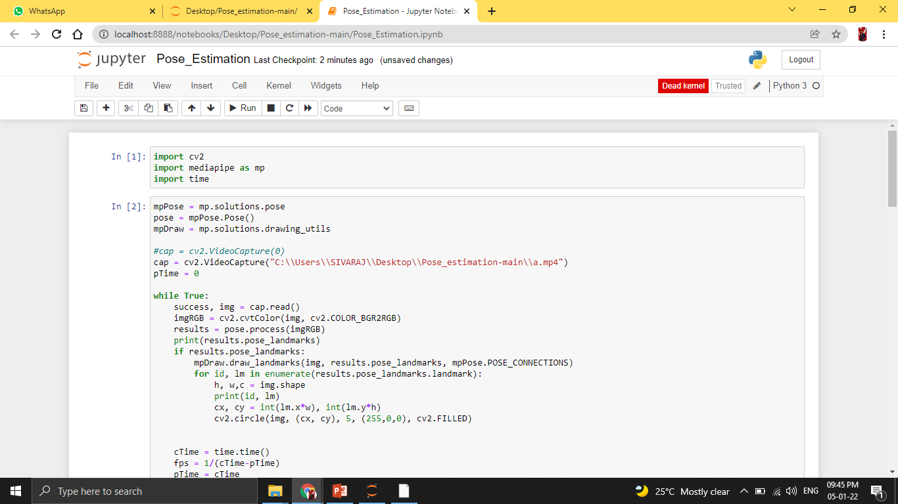

Slide 8
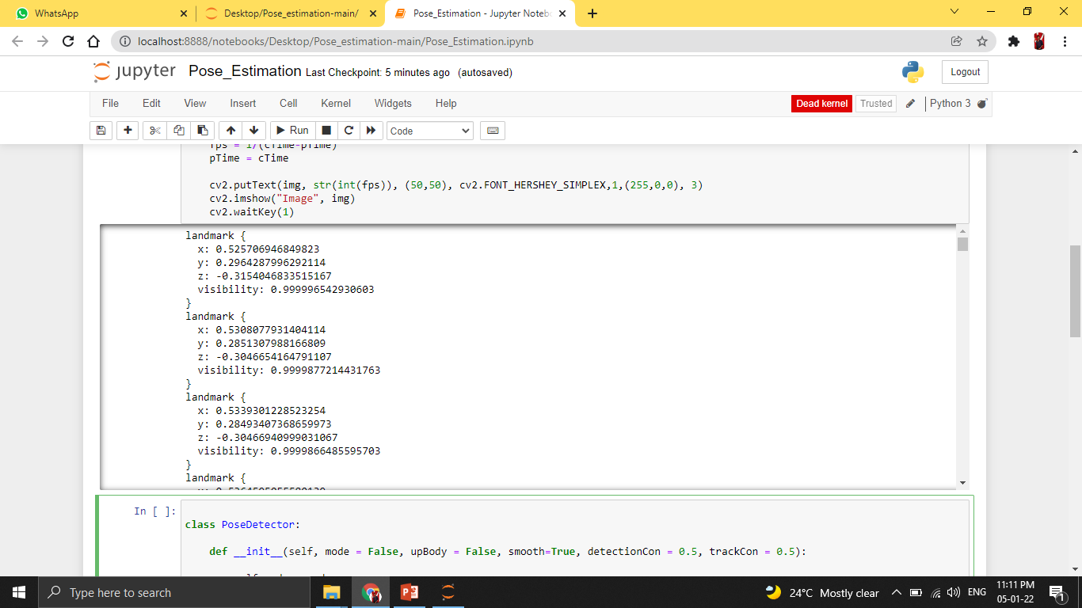

Slide 9
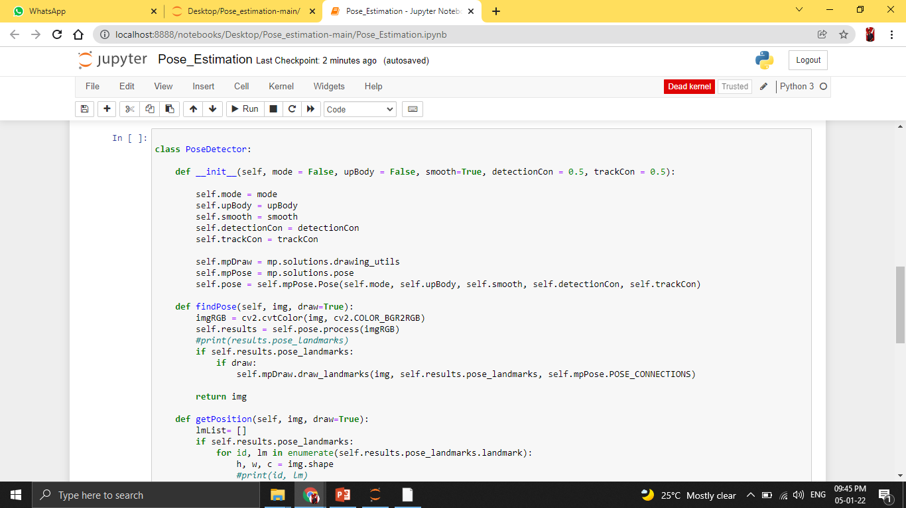

Slide 10
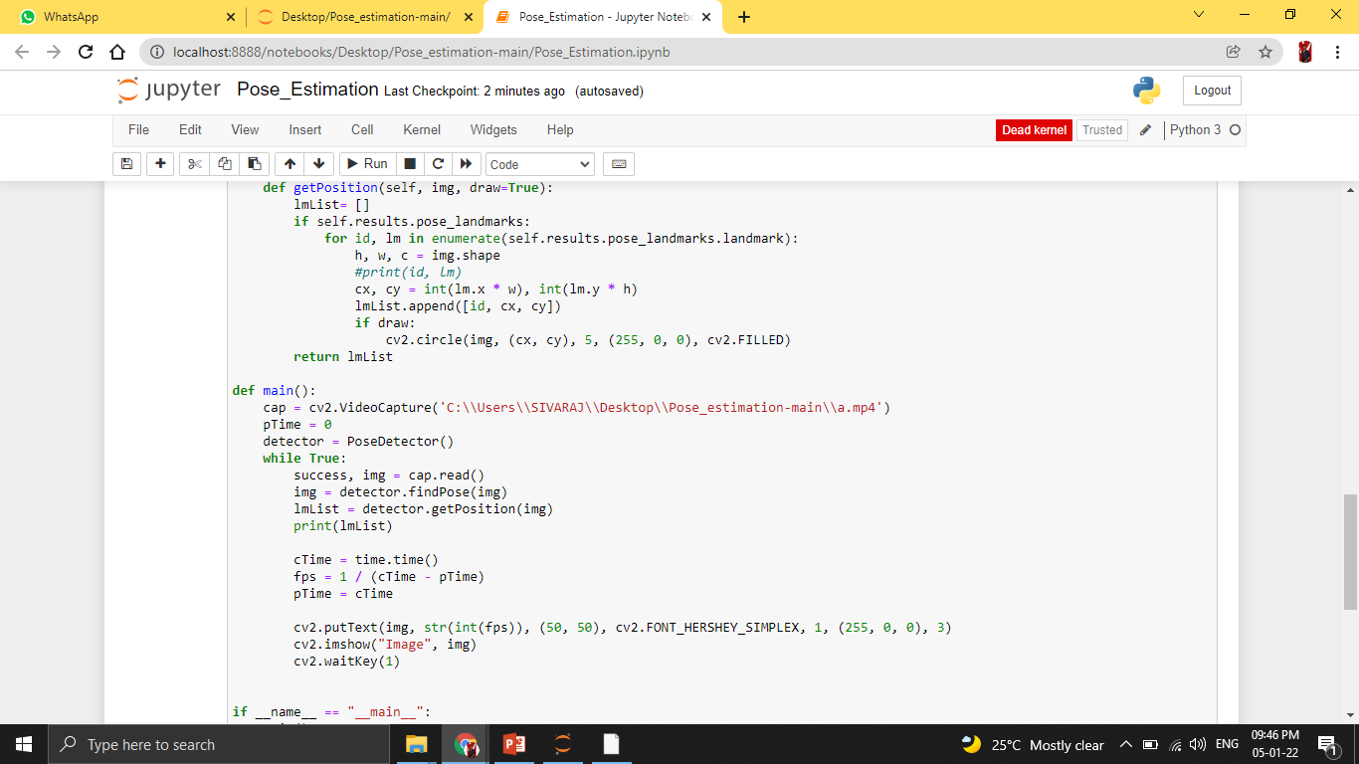

Slide 11
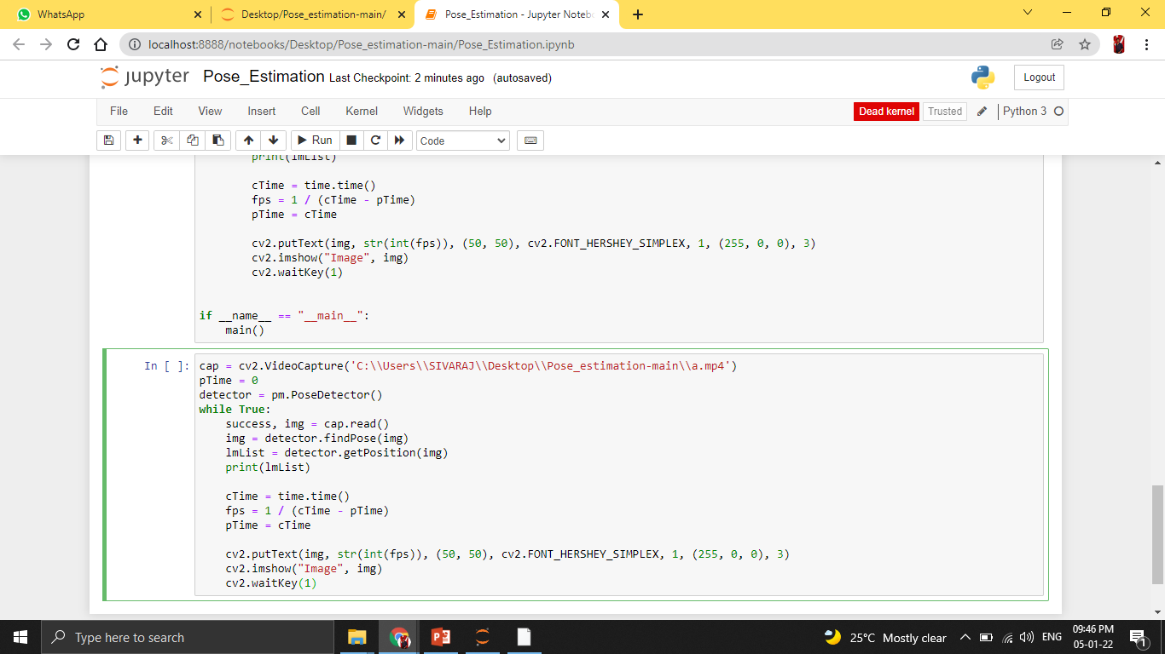

Slide 12
OUTPUT

Slide 13
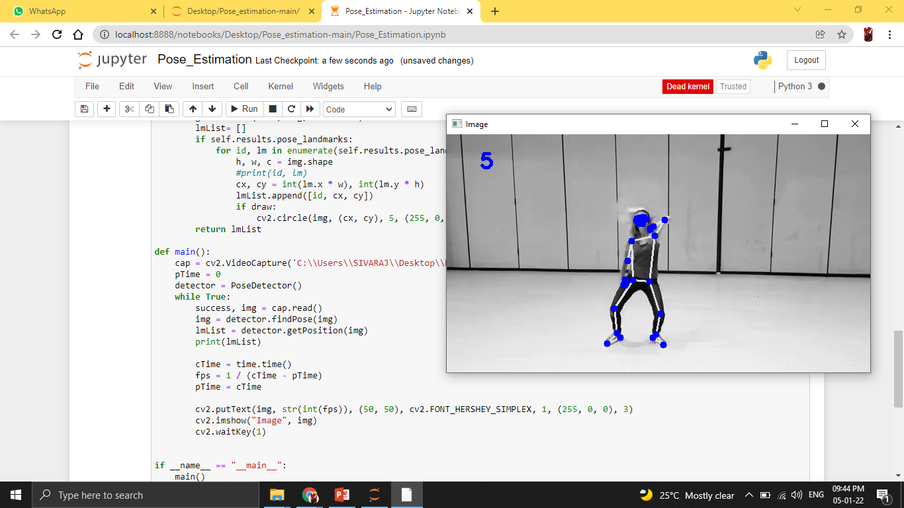

Slide 14
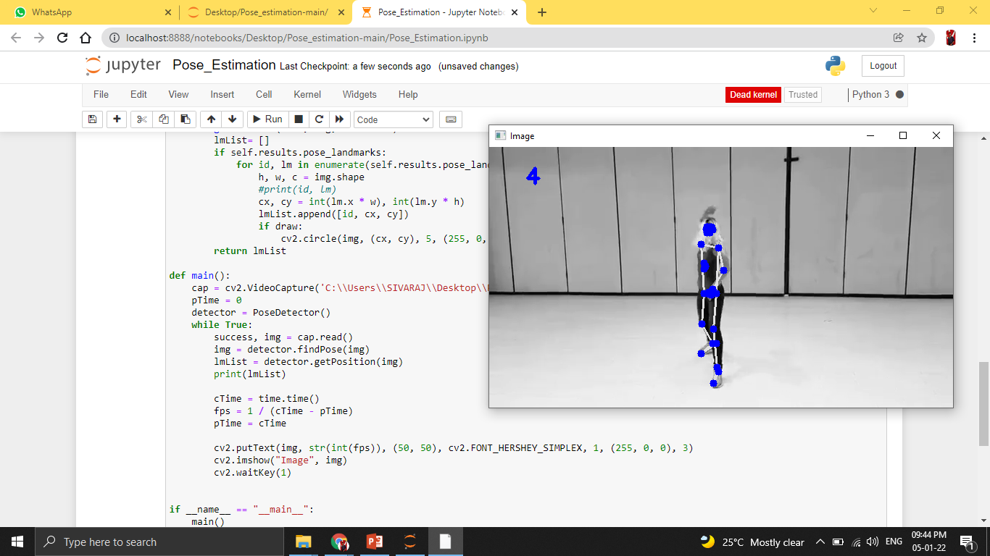

Slide 15
THANK YOU

